Slide 1
Drone Phenology Monitoring
Gaurav Rajput
Parth Thakur

Slide 2
Objective
Given two sets of crown polygons (OM3 and OM4)
OM3 is misaligned with respect to OM4
Goal: Affinely align OM3 to OM4 to maximize overlap (IoU)
Calculate A-B and B-A but with constraint

Slide 3
Initial Approach
For each matched pair, computed shift: Δx = x_OM4 − x_OM3, Δy = y_OM4 − y_OM3
Took mean of all shifts
Applied global translation to OM3 crowns
Problem:
Mean is sensitive to outliers (even 1–2 bad matches can shift the average)
Average Translation Vector

Slide 4
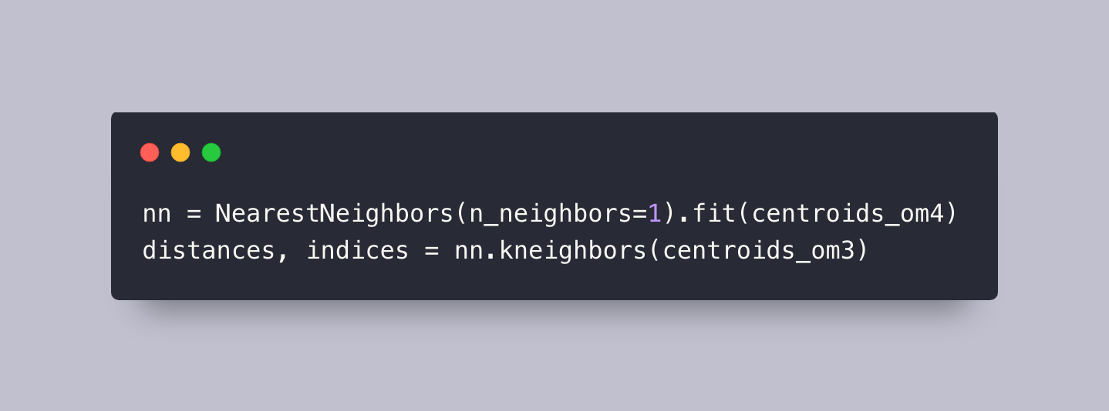
First Attempt
Computed centroids of all OM3 and OM4 crowns
Matched each OM3 centroid to its nearest OM4 neighbor
Outcome:
Final average IoU: 71%
Nearest Neighbor Matching

Slide 5
Median Translation Vector
Recomputed all pairwise shifts between matched centroids
Took median of all shifts instead of mean
Median is robust to outliers
Outcome:
IoU improved from 71% → ~80%
Why it works:
Median ignores extreme outliers and captures central tendency of majority-good matches

Slide 6
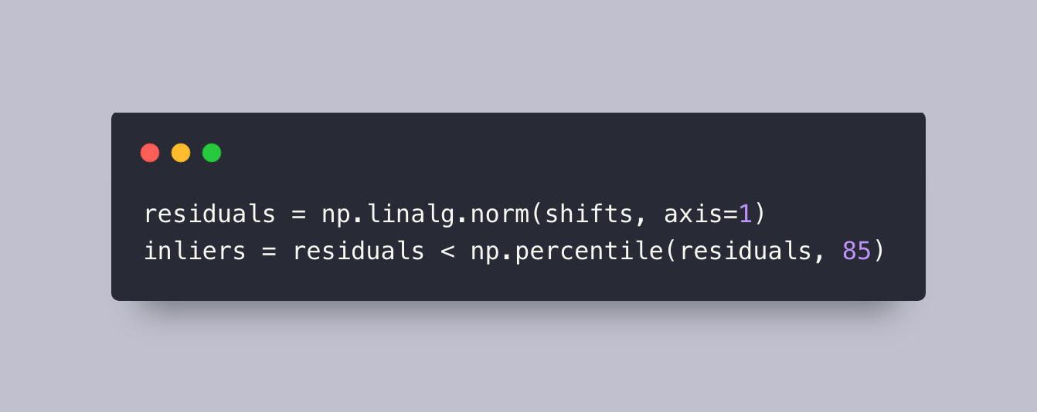
Final Enhancement
Calculated L2 norm of each shift vector (magnitude of shift)
Removed top 15% largest shifts:
Took median of remaining shifts
Outcome:
IoU improved further: 81.34%
Why this works:
Removes bad matches entirely (not just suppressing them)
Median over filtered data → better alignment with actual crown overlaps
Filtering Top 15% Shift Outliers

Slide 7
Post-Alignment
After alignment, performed polygon-wise IoU matching
For unmatched or low-overlap crowns:
Compute A−B and B−A
Choose the one with larger area
A−B vs B−A Difference Based on Area

Slide 8

problem
Largest crown overlap is A with the blue crown, so here shall I consider Blue-A or the yellow part between A, B and C
A
B
C

Slide 9
Thank You

